Slide 1

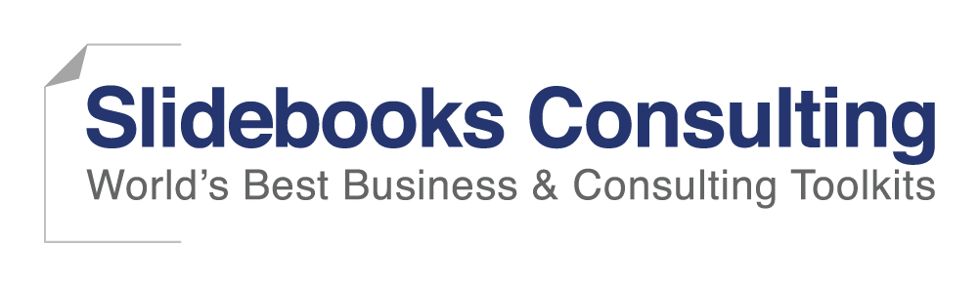
Culture Integration Strategy and Plan
Confidential
By ex-McKinsey, Deloitte & BCG Management Consultants

Slide 2
Culture integration strategy and plan
Phase I: Define & communicate the Strategy & High-Level Plan
Phase II: Develop & Communicate the Detailed Plans
Phase III: Implement & Monitor
Merger strategic objectives
Integration management office
Guiding principles
Post merger integration high-level plan
Organizational structure (Top 3 layers)
Top management appointment
Integrated synergy baseline
Synergy targets
Integration & synergy initiatives
Day 1 readiness checklist
Integration & synergy initiatives plan
Change management strategy and plan
Communication strategy and plan
Culture integration strategy and plan
Risk management strategy and plan
Staffing & retention plan
Post merger integration high-level plan
Day 1 readiness checklist
Integration & synergy initiatives plan
Change management strategy and plan
Communication strategy and plan
Culture integration strategy and plan
Risk management strategy and plan
Staffing & retention plan
Integration lessons learned
Playbook of the approach

Slide 3
There are many examples of mergers that didn’t work because of Cultural issues (1/2):
New York Central Railroad & Pennsylvania Railroad
In 1968, two longtime railway rivals, New York Central Railroad and Pennsylvania Railroad merged to become Penn Central, the sixth largest corporation in America. What Penn Central did not expect was that years of fierce competition made it impossible for the two companies to work cooperatively together. The company filed for bankruptcy after only two years.
Daimler & Chrysler
When German Daimler (the makers of Mercedes-Benz) merged with American company Chrysler in the late 1990s, it was called a “merger of equals.” A few years later it was being called a “fiasco.” Discordant company cultures had the two divisions at war as soon as they merged. Differences between the companies included their level of formality, philosophy on issues such as pay and expenses, and operating styles. The German culture became dominant and employee satisfaction levels at Chrysler dropped off the map. One unhappy joke circulating at Chrysler at the time was “How do you pronounce DaimlerChrysler?… ‘Daimler’—the ‘Chrysler’ is silent.” By 2000, major losses were projected and, a year later, layoffs began. In 2007, Daimler sold Chrysler to Cerberus Capital Management for $6 billion.
AOL & Time Warner
In January of 2000, Time Warner stock sold for $71.88. By 2008 you could buy a share of Time Warner for less than $15. What happened to the media giant? A failed $350 billion merger with AOL. Culture clash was widely blamed for the failure of the joint venture. Said Richard Parsons, president of Time Warner: “I remember saying at a vital board meeting where we approved this, that life was going to be different going forward because they’re very different cultures, but I have to tell you, I underestimated how different… It was beyond certainly my abilities to figure out how to blend the old media and the new media culture.”
Source: Globoforce

Slide 4
There are many examples of mergers that didn’t work because of Cultural issues (2/2):
Novell & WordPerfect
In 1986, WordPerfect was the nation’s best-selling word processing software. For the next few years the private software company grew steadily, despite being locked in a battle with rival Microsoft for market share. In March 1994, WordPerfect signed a merger agreement with Novell, Inc. It should have been a match made in heaven, but the management of the two companies were in conflict from the start. The merger was followed by layoffs at both companies and a steep drop in share value. With the focus on internal discord, WordPerfect lost its market leadership. Two years later, Novell sold WordPerfect to Corell for $1 billion less than they had paid.
Sprint & Nextel
In 2005, in a bid to keep pace with industry giants like Verizon & AT&T, Sprint acquired rival Nextel for $35 billion. By 2008, the company had written down 80% of the value of the Nextel, confirming the widely held belief that the merger had been a failure. That failure is widely attributed to a culture clash between the entrepreneurial, khaki culture of Nextel and the buttoned-down formality of bureaucratic Sprint. A Washington Post article written two years into the merger stated: “The two sharply different cultures have resulted in clashes in everything from advertising strategy to cellphone technologies.” In early 2012 Sprint announced it would be ridding itself of the Nextel network, marking what CNET calls “a concluding chapter in one of the worst mergers in history.”
HP and Compaq
In 2001, struggling computing giant Hewlett Packard announced it would acquire similarly struggling competitor Compaq. The merger was ill-fated from the start, as critics pointed out how the HP engineering-driven culture was based on consensus and the sales-driven Compaq culture on rapid decision making. This poor cultural fit resulted in years of bitter infighting in the new company, and resulted in a loss of an estimated 13 billion dollars in market capitalization. Though the merger itself was widely regarded as a failure, the company has hung on, and has been able to make significant cultural and leadership changes that have resulted in long-term success.
Source: Globoforce

Slide 5
See below a proven approach to mitigate the risk of failure due to cultural mismatch
Pre deal
Post deal
1.High-level assessment of the two corporate cultures
2.Detailed assessment of the two corporate cultures
3.New corporate culture design
4.New corporate culture implementation

Slide 6
Phase 1: High-level assessment of the two corporate cultures
The phase 1 should occur pre-deal. Theoretically, once the High-level assessment of the two corporate cultures is done, a “Go or No Go” decision should be taken. However, in practice, most of the stakeholders will tend to only focus on the potential synergies that could be reached out of the deal.
The problem is that if the cultures of the acquiring and target companies are too far away, the synergy target identified pre-deal will almost never be reached.

Slide 7
Phase 2: Detailed level assessment of the two corporate cultures (1/3)
Developing a detailed level assessment of the two corporate cultures can be a little bit complex. We usually recommend to outsource this phase by using a third party such as, for example, Human Synergistics.
Human Synergistics uses a Circumplex tool which provides a way to see, measure, and change the thinking and behavioral styles proven to drive the performance of not only individuals, but also groups and organizations. it enables you to use a common language and visual model for development across 5 levels:
Individual: Thinking and behavioral styles of leaders and other key members
Leader/Manager: Impact of leaders/managers on the styles of the people around them
Group: Interaction styles of members of problem-solving groups
Organization: Organizational culture in terms of values (Ideal) and behavioral norms (Current)
Customer: Styles exhibited by service providers when interacting with customers

Slide 8
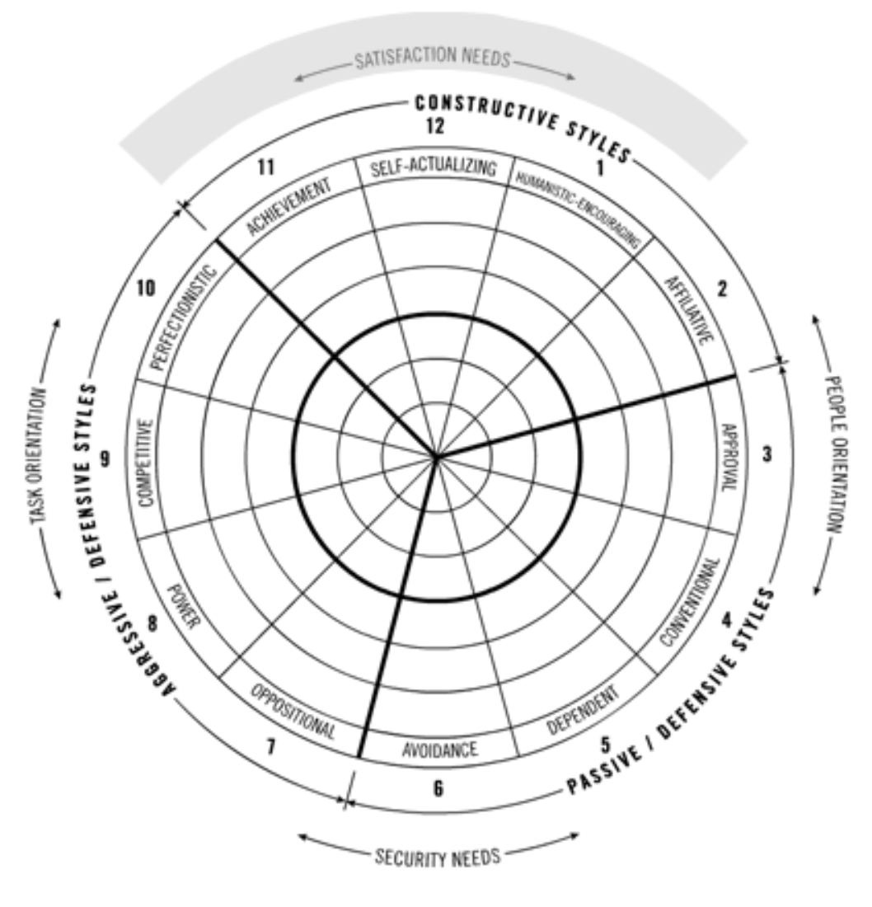
Phase 2: Detailed assessment of the two corporate cultures (2/3)
The Circumplex

Slide 9
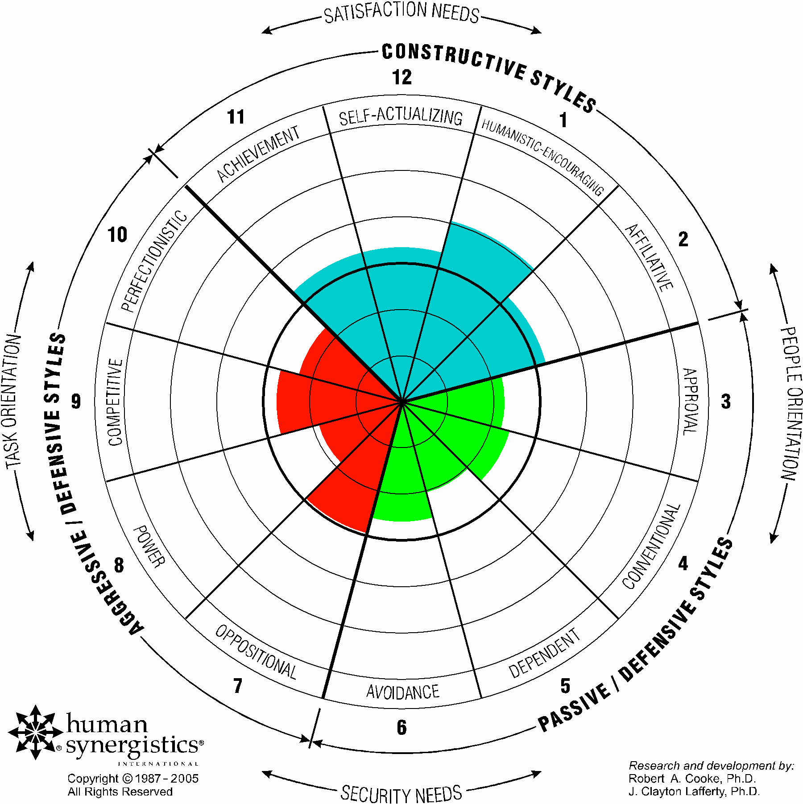
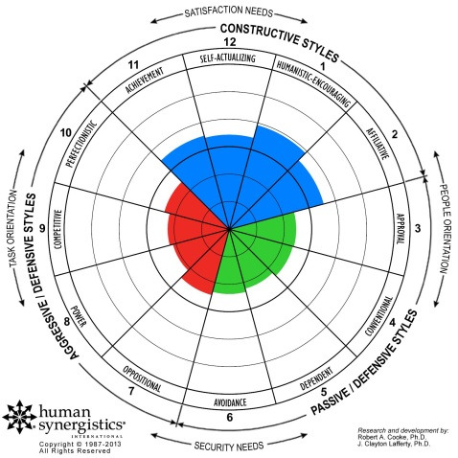
Phase 2: Detailed assessment of the two corporate cultures (3/3)
Illustration
Acquiring company current state
Acquired company current state

Slide 10
Phase 3: New corporate culture design
Based on the detailed assessment, Executives, Managers and Employees from the acquiring and acquired companies will have to collaboratively design the new corporate culture.
Many workshops will have to be organized where key stakeholders will have to answer questions such as:
How do we want to work together as a company in the future?
What should be our core values?
The new culture will have to help the company achieve its vision and strategic goals.
It will have to be communicated throughout the organization and serve as the foundation for the program of ongoing actions.

Slide 11
Phase 4: New corporate culture implementation
Implementing a new corporate culture is not an easy task. The top 5 key success factors to implement a new corporate culture are:
To involve as many stakeholders as possible during the new corporate culture design phase
To provide as much openness and transparency as possible
To reflect the new culture in the company incentive & reward program
To communicate regularly and effectively on the new culture
To make sure that every executive is a good role model

Slide 12
Thanks for your attention!
www.slidebooks.com

